Slide 1
Notes:
Introduce yourself and your affiliation.
Find a way to connect with your audience: Either share a little of your background (what led you to your role) or go around the room and do brief introductions (name, year, FOS, country of interest, what are you passionate about?)
Big Picture: The Fulbright U.S. Student Program, provides 1-year, fully funded grants for graduating seniors, recent graduates, graduate students, and young professionals to conduct individually designed research projects, enroll in graduate school, or teach English abroad.

Slide 2
The Fulbright Program
Program Goal
History and Administration
Our mission is to foster mutual understanding between nations, advance knowledge across communities, and improve lives around the world
Created in 1946 by U.S. Congress
Sponsored by the U.S. Department of State’s Bureau of Educational and Cultural Affairs (ECA)
U.S. Student Program administered in the U.S. by IIE
Administered overseas by bi-national Commissions and U.S. Embassies
Notes:
For this slide, it is important to stress that the Fulbright program is an international exchange program.
Proposed in 1945 by Arkansas Senator J. William Fulbright and signed into law by President Truman on August 1, 1946, the Fulbright Program is the flagship international educational exchange program sponsored by the U.S. government.
The advancement of our mission of fostering mutual understanding between nations, advancing knowledge across communities, and improving lives around the world is the heart of Fulbright.
Fulbright is an opportunity to build lasting relationships, expand one's network and advance one's career
The Fulbright Program not only offers grants to U.S. students and scholars to go abroad, but also offers grants to foreign students and scholars to come to the United States. Since its inception in 1945, the program has grown from just 88 grantees in the first year to over 8,000 annually.

Slide 3
Diversity and Inclusion
Fulbright strives to ensure that it reflects the diversity of U.S. society and societies abroad. Fulbright encourages the involvement of people from traditionally underrepresented audiences in all grants, programs, and other initiatives.
Opportunities are open to people regardless of their race, color, national origin, sex, age, religion, geographic location, socioeconomic status, disability, sexual orientation, or gender identity.
Notes:
Diversity and Inclusion are cornerstone principles of the program
We are actively recruiting a diverse pool of applicants for the Fulbright program. Please encourage all people to consider Fulbright.
We've dedicated our time, energy and resources into finding talent.
We know that talent is everywhere and that's why I'm here today
We desire to have this program represent the diversity that makes up the U.S. and the U.S. Higher Education system

Slide 4
Fulbright U.S. Student Eligibility
Basic Eligibility
Graduating Seniors
Recent Graduates
Graduate Students
Early Career Professionals, including creative and performing artists/musicians
U.S. citizen by the application deadline
Open to:
Bachelor’s degree or equivalent by start of grant
No Doctorate at the time of application
Additional Country-specific requirements
Notes:
The awards are open to all FOS, disciplines and areas of interest from the hard sciences to the creative and performing arts
Applicants to the Fulbright U.S. Student Program must be U.S. citizens at the time of application
Applicants must have a conferred bachelor's degree or the equivalent before the start of the grant.
Not have a PhD at the time of application
You do not have to be enrolled in an institute of higher education to be eligible
Have sufficient proficiency in the written and spoken language of the host country in order to communicate with the people and carry out the proposed project.
Fulbright is not one program, but 140 different programs because we are working with over 140 countries. Please consult the intended host country page on our website for country-specific detailed requirements.
During each competition cycle, candidates can only apply to one type of grant. Fulbright grants are traditionally for one country

Slide 5
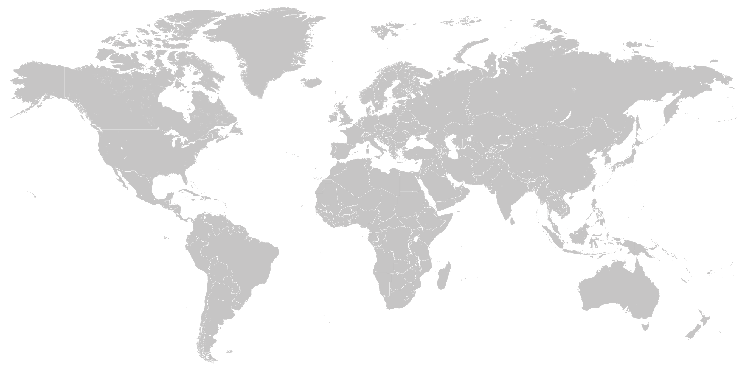
Program Award Types
Study/Research Grant
Independent research, study, or arts projects abroad
2,200+
Awards
__
140+
Countries Worldwide
950+
8-10
~140
Awards
Months
Countries
English Teaching Assistantship (ETA)
Help teach English and U.S. culture in the classroom
1,250+
8-10
~75
Awards
Months
Countries
Notes:
With over 2,200 awards to over 140 different countries, there are many opportunities to pursue your passion abroad
Fulbright U.S. Student Program grants fall into two categories: Open Study/Research awards and English Teaching Assistantships
Study/Research Awards: Opportunity to build your own adventure. Candidates for the Open Study/Research grant include those proposing independent study or research abroad; independent research while taking classes as a non-degree seeking student at a foreign university; or, to directly enroll in a graduate degree program abroad.
Independent research- Intellectually compelling and feasible project
Graduate Degree Enrollment- Applicant should specify the reasons for applying to proposed program at a particular institution in the host country. Applicants applying for graduate degree enrollment are traditionally responsible for securing admission to the university through the institution’s application process in addition to submitting a Fulbright application.
Hybrid b/w research and non-degree seeking
Creative & performing arts
English Teaching Assistantship: The ETA program places grantees in schools overseas to supplement local English language instruction and to provide a native English speaker presence in classrooms. Placements and experience vary by country so the first step, is to familiarize yourself with the country summary for the program to which you are applying.

Slide 6
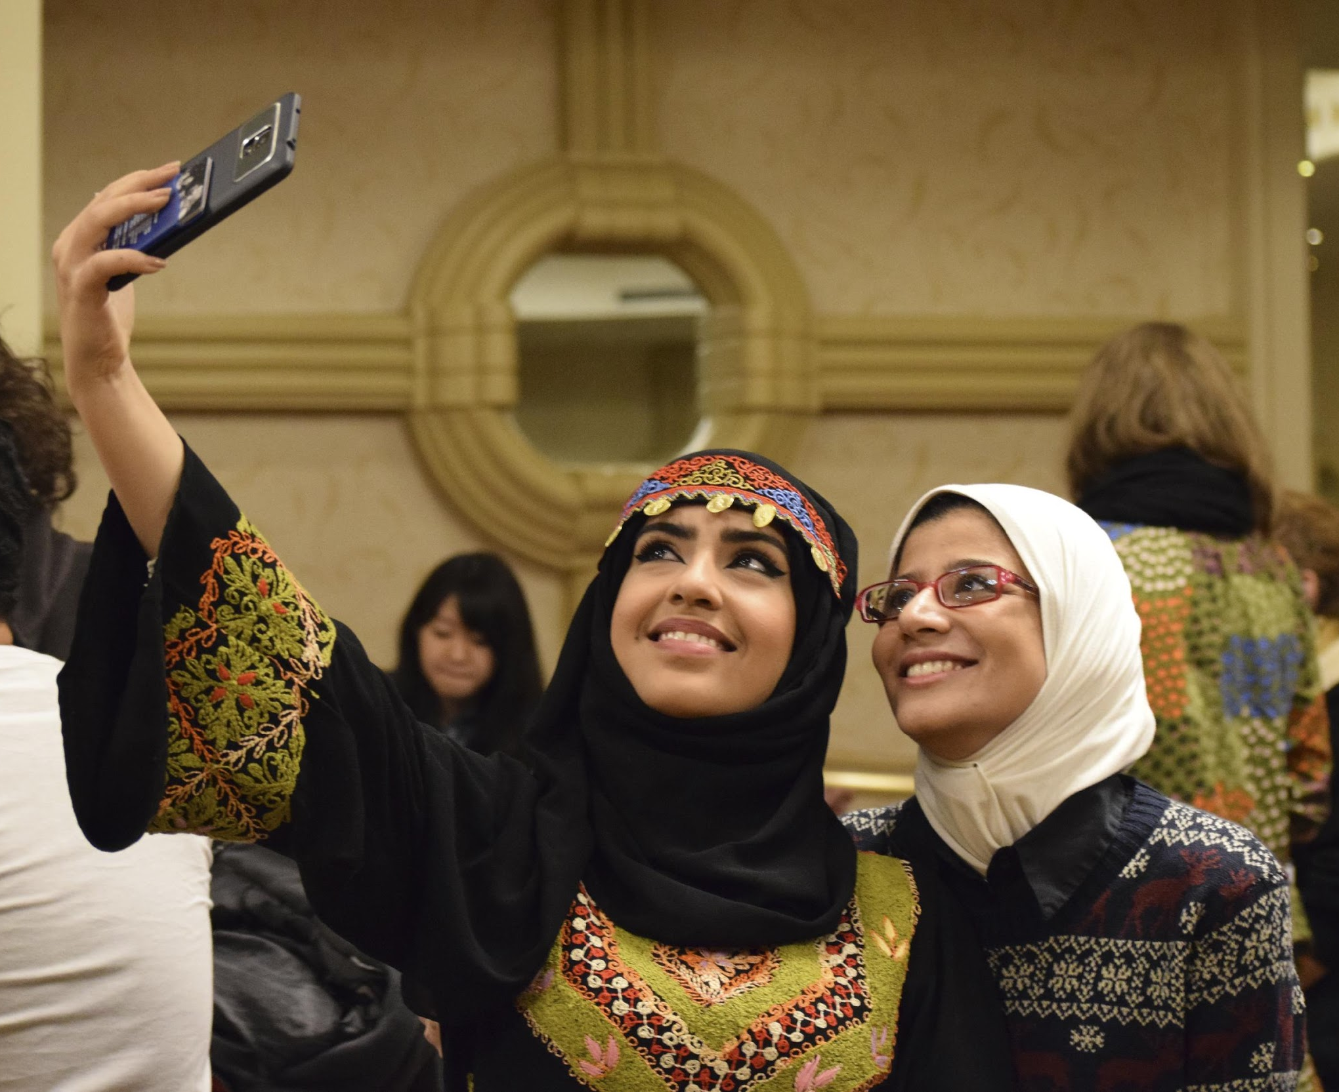
Award Benefits
Pre-Grant & In-Country
Post-Grant
Round-trip airfare
Monthly stipend*
Accident and sickness benefits
Other possible benefits*
• Support for dependents
• Research allowance
• Tuition
• Language lessons
• Enhancement activities
• Disability-related accommodations
The Fulbright Network of Alumni
State Department’s Alumni Website
Eligible for 12 months of noncompetitive eligibility (NCE) hiring status within the federal government
Lifetime Fulbright email address
Fulbright Association
* Varies depending on grant and host country.
Notes:
The actual dollar amount of the grant varies by country and award type, but all grants provide for the following: round-trip transportation from the U.S. to the host country, funding to cover housing, meals, and incidentals, and basic accident and sickness health benefits.
Living costs are based on a graduate student’s standard of living and the cost of living in the host country
Other benefits may include: support for dependents, research allowance, tuition, language lessons and/or enhancement activities
Disability related support is also available to grantees. Applicants with disabilities are encouraged to contact Mobility International at miusa.org for more information on the support available internationally

Slide 7
English Teaching Assistant
Typically act as the assistant to a main teacher
Do not have to be English majors or minors
Needs to show strong communication skills
Placed by Fulbright (no need to seek a letter of affiliation)
Community Engagement is needed (lots of options here)
List of ETA options on website (countries, language needed, number of slots, placement options)
Notes:
SHOW ETA CHART

Slide 8
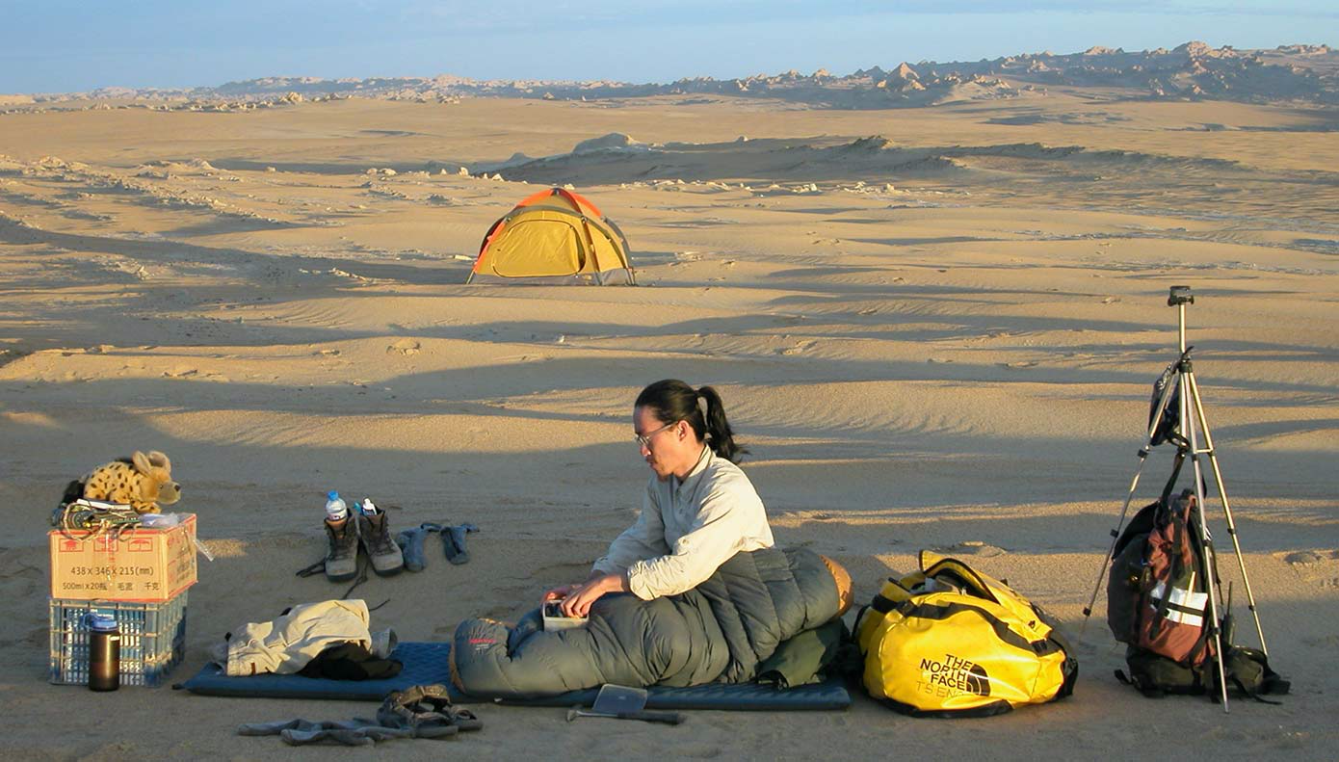
Research Fulbright
Prior research experience is recommended before applying
Need a letter of affiliation (student finding their own placement)
Three ways to find affiliation: direct affiliation, networking, and cold calling
All majors are welcome a majority of the time
Community Engagement needed
Jack Tseng - China, 2008

Slide 9
Creative and Graduate School Fulbright
Creative Fulbright
May need affiliation
Will need to submit supplementary materials showing your skills
Available for areas in*:
· Architecture
· Creative Writing
· Music
· Performing Arts
· Visual Arts
*for a full list of all fields of study, please visit https://us.fulbrightonline.org/required-supplementary-materials-for-arts-applicants
Graduate School
Limited Options for earning a graduate degree overseas
Check Fulbright website for current options
Apply for both the Fulbright and grad school at same time
Typically no affiliation required
Notes:
ADD GRAD SCHOOL CHART

Slide 10
Application Components
Basic Personal Data & Program Information
Abstract, Host Country Engagement, Future Plans
2. Essays
Statement of Grant Purpose
Research/Study (2 page max)
English Teaching Assistantship (1 page max)
Personal Statement (1 page max)
3. Reports / References
Foreign Language Evaluation
Three (3) References
Campus Committee Evaluation
4. Transcripts
5. Other
Research/Study: Affiliation Letter(s)
Arts: Supplementary Materials
Notes:
Within the Fulbright Application system, preliminary questions will impact the information that will be visible on subsequent pages of the application. As such, these must be answered correctly.
Short answer questions:
Essays: The heart of the application. This is where you should address the what, when, where, why, and how of your Fulbright project.
The Statement of Grant Purpose for S/R awards is a 2-page document detailing an intellectually-compelling and feasible project proposal or justification for pursuing a graduate degree program.
The Statement of Grant Purpose should make it clear why you must go to the host country in order to complete your proposed research or study program, and that you have the requisite academic or professional experience and language skills to fulfill your proposal.
The Statement of Grant Purpose for ETA awards is a 1-page document detailing why you are interested in teaching English to non-native speakers, as well as why you have chosen to apply to a particular country.
The Statement should describe any teaching or related experience, while clearly describing what you will bring to the classroom in the host country; including lesson plans, activity ideas, and educational strategies you plan to implement.
The Personal Statement is a 1-page biography in narrative form. It is an opportunity to introduce yourself to the screening committee members on a personal level.
The style is up to the writer, but the content should convey one's background and motivation for applying to the program and how this opportunity fits into one's future plans.

Slide 11
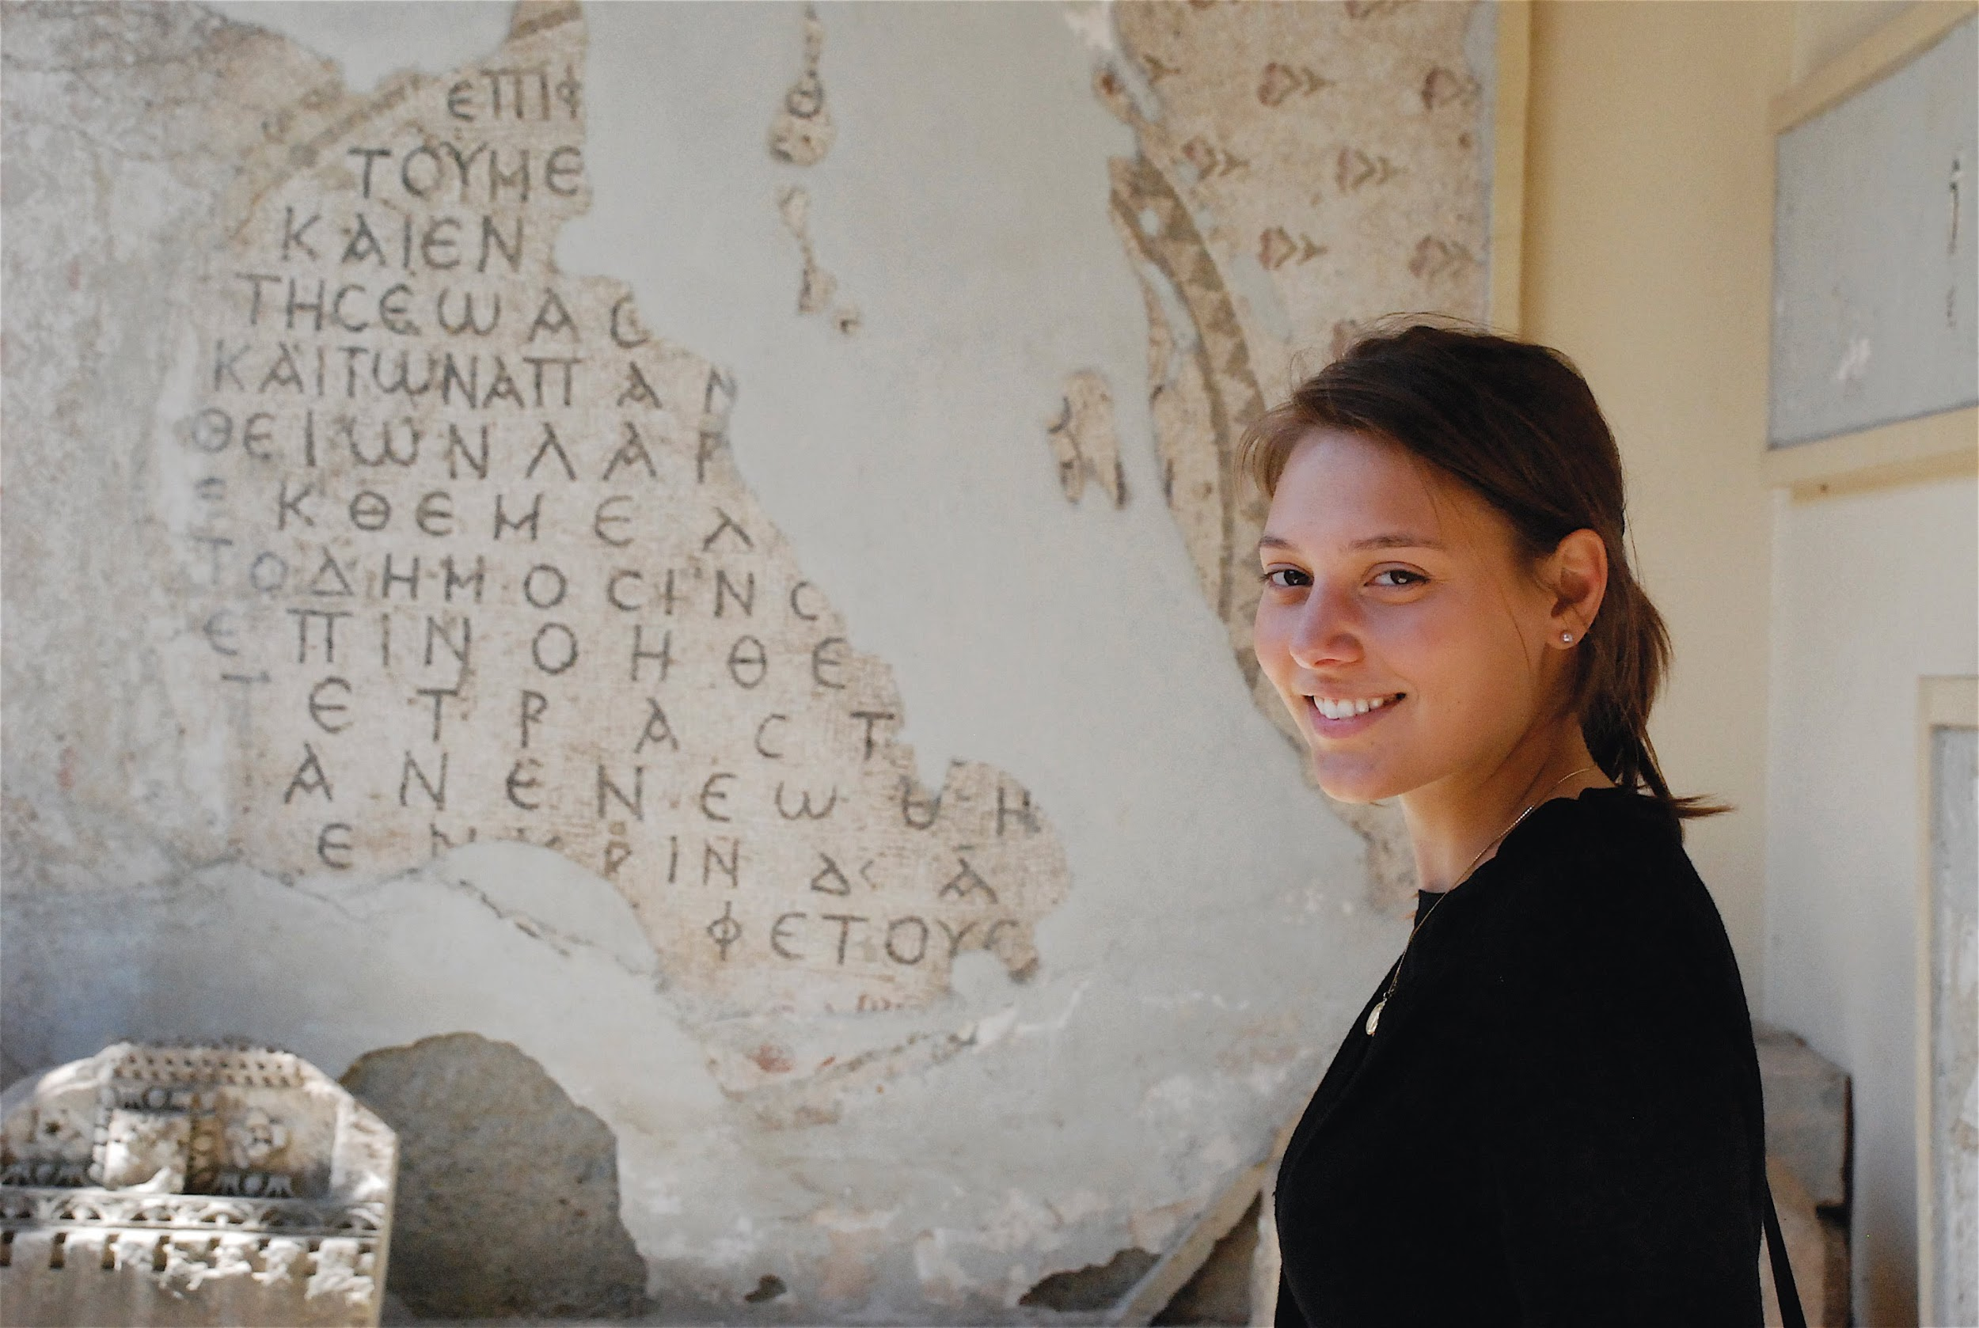
Factors in Selection
Quality and feasibility of the proposal
Academic or professional record
Personal qualifications
Language preparation
Preference factors as established by Foreign Fulbright Scholarship Board
Extent to which the candidate and the project will help to advance the Fulbright Program goals
Requirements of the program in individual countries
Desirability of achieving diversity
Notes:
Selection is made on the basis of: quality and feasibility of the proposal; academic or professional record; personal qualifications; language preparation; the preference factors established by the Fulbright Foreign Scholarship Board; and, the extent to which the candidate and the project will help to advance the Fulbright aim of promoting mutual understanding and achieving diversity.
Additionally, each country may set specific requirements regarding eligibility and preference selection factors. Country specific information is available on our website us.fulbrightonline.org.

Slide 12
Application Timeline
APRIL–SEPTEMBER
Design Project and Prepare Application
SEPTMEBER
Campus deadline-August 26/ Campus Interview September 13-18
OCTOBER 12 2021
National Application Deadline, due by 5:00 p.m. ET
NOVEMBER–DECEMBER
U.S. Review: National Screening Committees
JANUARY–MAY
Host Country Review: Fulbright Commissions and/or U.S. Embassy
MARCH–JUNE
Final Selection and Notification: Fulbright Foreign Scholarship Board
Notes:
The application cycle opens annually at the end of March.
Applicants are encouraged to begin the process of selecting a grant and country and contacting their Fulbright Program Adviser and other possible advisers who will assist with application preparation. Applicants should begin designing their project and preparing their application as soon as possible after the application cycle begins.
National deadline is Tuesday, Oct. 13th, 2020 at 5pm ET. We will Not accept any applications after that date and time.
After the National Deadline in October, applications will be reviewed by the National Screening Committee (or NSC). The NSC meetings are comprised of U.S. college faculty and professionals representing various academic and artistic disciplines from institutions across the United States.
Applicants will be notified in the application system, as early as December, if they are selected as a Semi-Finalist and their application recommended to the host country for further review.
Fulbright Commissions and U.S. Embassies review semi-finalist applications and make selections. Country selections are then approved by the J. William Fulbright Foreign Scholarship Board.
In most cases, grant dates correspond to the academic calendar of the host country. Approximate dates of the academic year in each country can be found its Country Summary page on our website, us.fulbrightonline.org.

Slide 13
Options Aside from Fulbright
JET Program
Peace Corps
Critical Language Scholarships (CLS)
English Teaching in other countries
NSF Graduate Fellowship for STEM majors
UK Fellowships like Gates-Cambridge, Rhodes, etc.
For more information about Fulbright or other Scholarship opportunities, visit www.mtsu.edu/honors/ufo

Slide 14
Other Steps
Learn more by using their resources
Read the Fulbright website and use their search engine.
Schedule a meeting
Please watch the 10-minute tutorial videos at: https://us.fulbrightonline.org/tutorials and their YouTube channel.
Students should review the country information (if known) before scheduling an appointment.
Email Laura Clippard to schedule phone or ZOOM appointment and include the following information: M-number, language(s) they speak, country or countries that they are considering for the Fulbright, and graduation date.

